Slide 1

Are Wind Speed and Wave Height Coherent?
Notes:
Event Attribution study looking at the role of humans in causing the California drought in the early 2010s

Slide 2
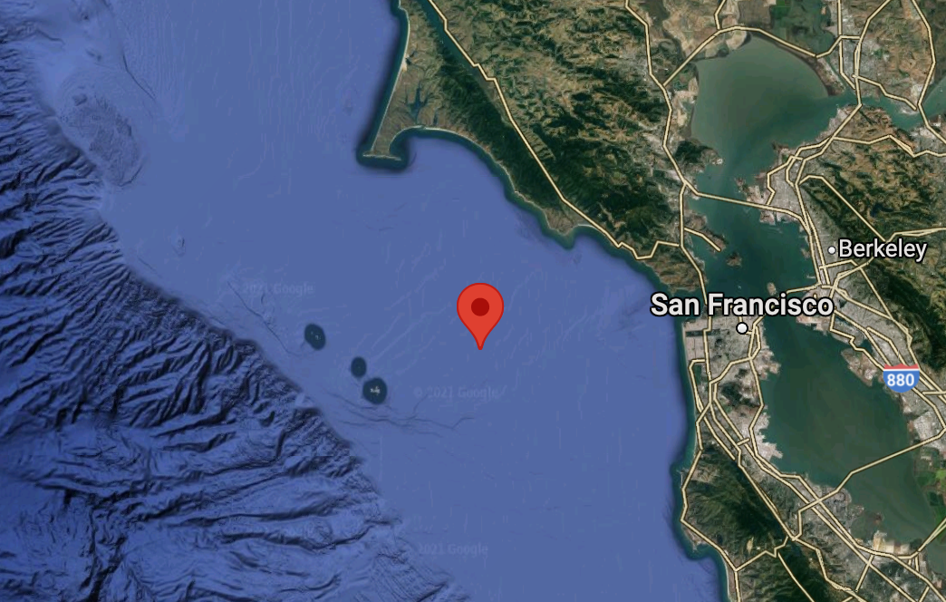
National Data Buoy Center 46026
37.7N, 122.8W

Slide 3

Hourly Wind Speed
Notes:
The authors postulate that long term warming caused by humans has altered the probability that precipitation deficits yield extreme drought in California.

Slide 4
Hourly Wind Speed
Hourly Significant Wave Height
Notes:
The authors postulate that long term warming caused by humans has altered the probability that precipitation deficits yield extreme drought in California.

Slide 5

1995-2021
Notes:
The authors postulate that long term warming caused by humans has altered the probability that precipitation deficits yield extreme drought in California.

Slide 6
1995-2021
330618 hourly records
Notes:
The authors postulate that long term warming caused by humans has altered the probability that precipitation deficits yield extreme drought in California.

Slide 7
1995-2021
330618 hourly records
328657 good wind speed records
Notes:
The authors postulate that long term warming caused by humans has altered the probability that precipitation deficits yield extreme drought in California.

Slide 8
1995-2021
330618 hourly records
328657 good wind speed records
214131 good wave height records :(
Notes:
The authors postulate that long term warming caused by humans has altered the probability that precipitation deficits yield extreme drought in California.

Slide 9
1995-2021
330618 hourly records
328657 good wind speed records
214131 good wave height records :(
Gaps in ‘98, ‘00 and ‘09-‘10 :((
Notes:
The authors postulate that long term warming caused by humans has altered the probability that precipitation deficits yield extreme drought in California.

Slide 10
2003-2017
Notes:
The authors postulate that long term warming caused by humans has altered the probability that precipitation deficits yield extreme drought in California.

Slide 11
2003-2017
124769 records
Notes:
The authors postulate that long term warming caused by humans has altered the probability that precipitation deficits yield extreme drought in California.

Slide 12
2003-2017
124769 records
124440 good records
Notes:
The authors postulate that long term warming caused by humans has altered the probability that precipitation deficits yield extreme drought in California.

Slide 13
2003-2017
124769 records
124440 good records
Careful segmenting to avoid ‘09-‘11 gap
Notes:
The authors postulate that long term warming caused by humans has altered the probability that precipitation deficits yield extreme drought in California.

Slide 14
2003-2017
124769 records
124440 good records
Careful segmenting to avoid ‘09-‘11 gap
Linear interpolation for small gaps
Notes:
The authors postulate that long term warming caused by humans has altered the probability that precipitation deficits yield extreme drought in California.

Slide 15
32 segments
133 days/segment
Notes:
The authors postulate that long term warming caused by humans has altered the probability that precipitation deficits yield extreme drought in California.

Slide 16
32 segments
133 days/segment
8 segments
507 days/segment
Notes:
The authors postulate that long term warming caused by humans has altered the probability that precipitation deficits yield extreme drought in California.

Slide 17
32 segments
133 days/segment
8 segments
507 days/segment
50% overlap → 14 total segments
Notes:
The authors postulate that long term warming caused by humans has altered the probability that precipitation deficits yield extreme drought in California.

Slide 18
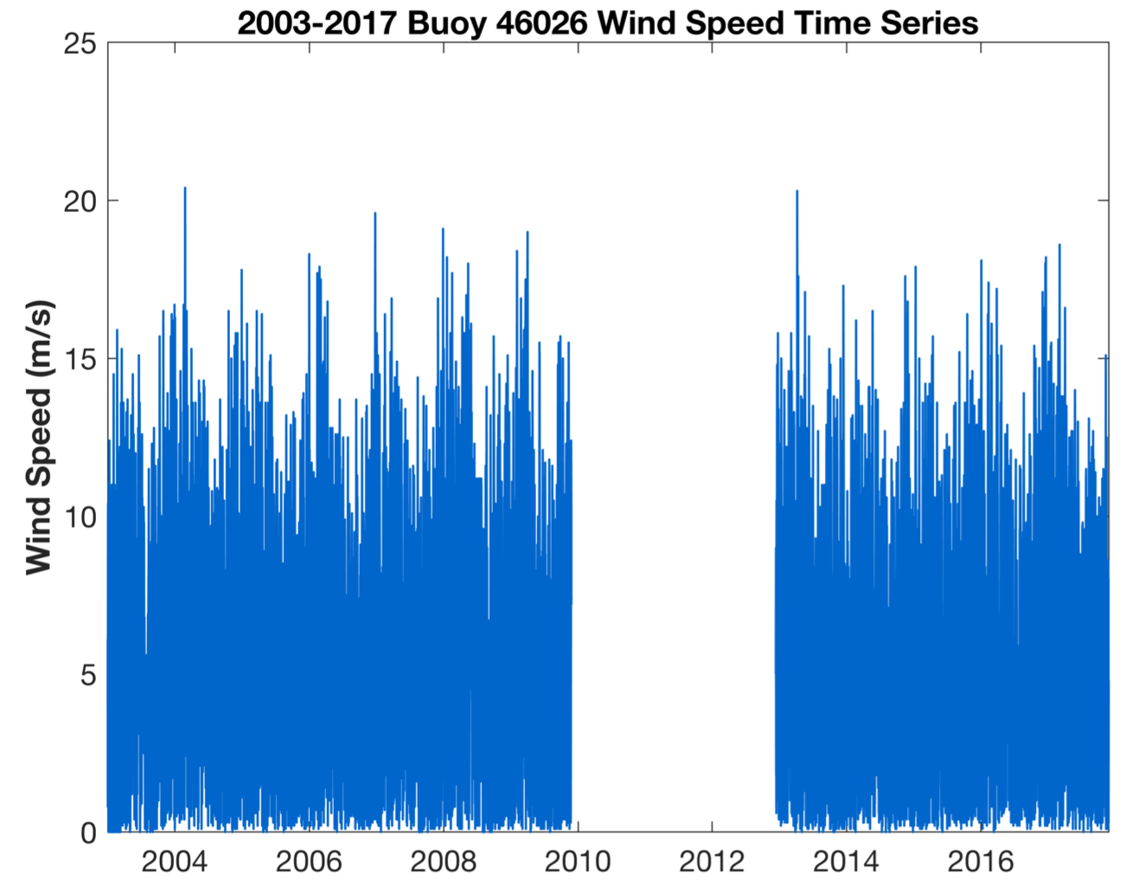
Notes:
So what were the results of this analysis?
20 total 1-SD droughts in the 118 year period
14 between 1896-1994
6 between 1995 and 2014
14% probability in nearly 100 year period
30% probability in 9 year period
All 20 events occured in -0.5 SD precipitation anomalies (not surprising → need moderately low precipitation for a drought to occur)
Precipitation deficits are more likely to produce 1-SD drought in warm years
Warm-Dry years have have occurred 2x more often in past 20 years than previous century

Slide 19
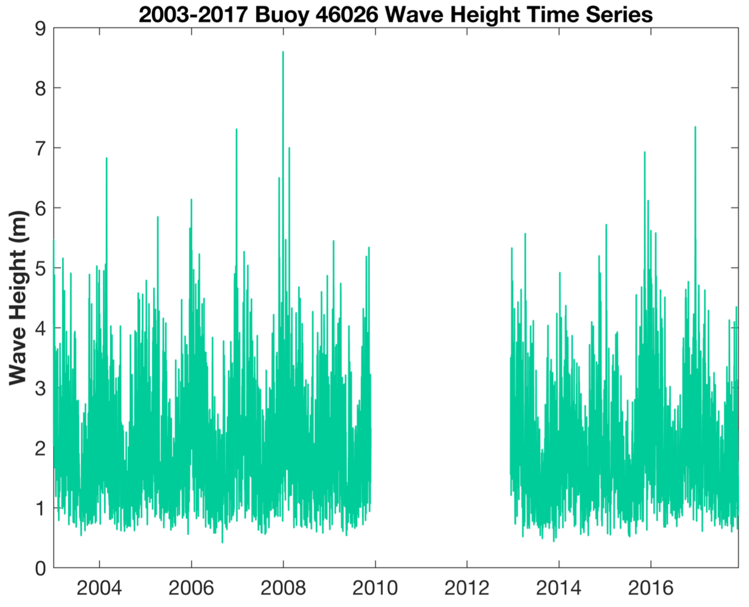
Notes:
So what were the results of this analysis?
20 total 1-SD droughts in the 118 year period
14 between 1896-1994
6 between 1995 and 2014
14% probability in nearly 100 year period
30% probability in 9 year period
All 20 events occured in -0.5 SD precipitation anomalies (not surprising → need moderately low precipitation for a drought to occur)
Precipitation deficits are more likely to produce 1-SD drought in warm years
Warm-Dry years have have occurred 2x more often in past 20 years than previous century

Slide 20
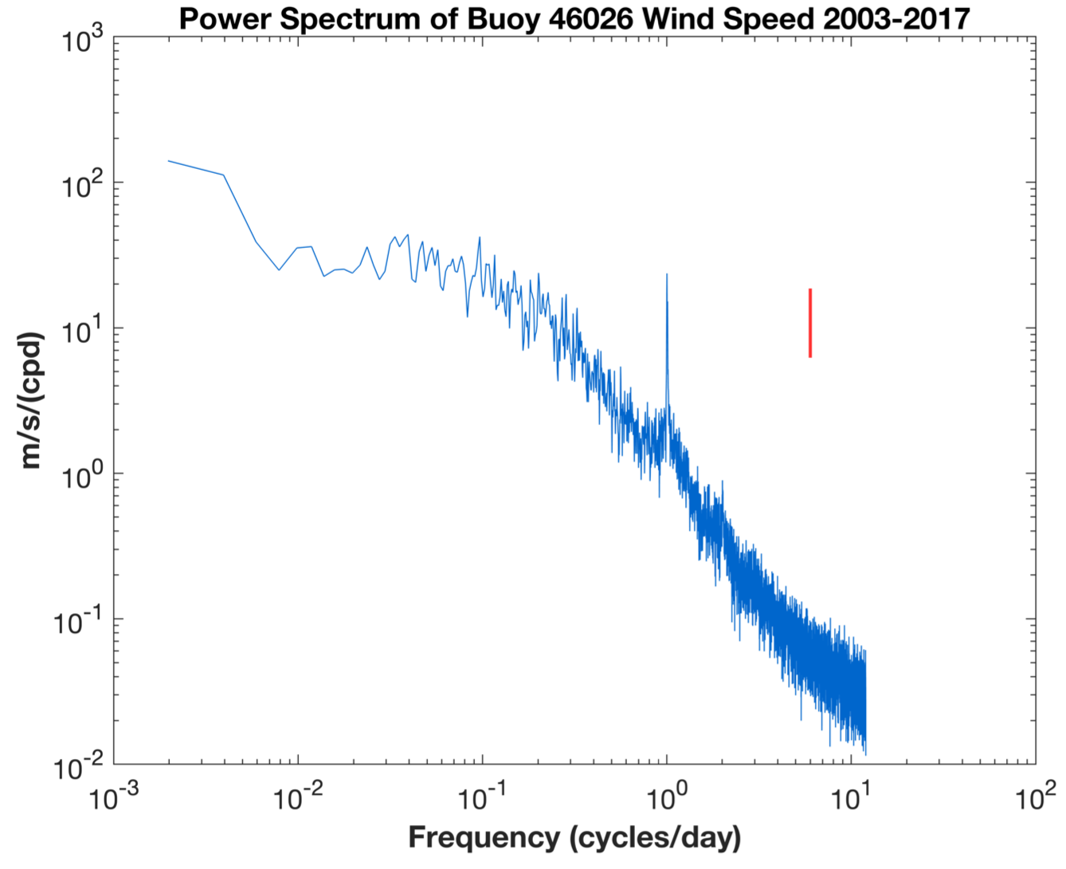
Notes:
So what were the results of this analysis?
20 total 1-SD droughts in the 118 year period
14 between 1896-1994
6 between 1995 and 2014
14% probability in nearly 100 year period
30% probability in 9 year period
All 20 events occured in -0.5 SD precipitation anomalies (not surprising → need moderately low precipitation for a drought to occur)
Precipitation deficits are more likely to produce 1-SD drought in warm years
Warm-Dry years have have occurred 2x more often in past 20 years than previous century

Slide 21
1 cycle/507 days
Nyquist Frequency
12 Cycles/Day
Notes:
So what were the results of this analysis?
20 total 1-SD droughts in the 118 year period
14 between 1896-1994
6 between 1995 and 2014
14% probability in nearly 100 year period
30% probability in 9 year period
All 20 events occured in -0.5 SD precipitation anomalies (not surprising → need moderately low precipitation for a drought to occur)
Precipitation deficits are more likely to produce 1-SD drought in warm years
Warm-Dry years have have occurred 2x more often in past 20 years than previous century

Slide 22
1 cycle/year
1 cycle/day
Notes:
So what were the results of this analysis?
20 total 1-SD droughts in the 118 year period
14 between 1896-1994
6 between 1995 and 2014
14% probability in nearly 100 year period
30% probability in 9 year period
All 20 events occured in -0.5 SD precipitation anomalies (not surprising → need moderately low precipitation for a drought to occur)
Precipitation deficits are more likely to produce 1-SD drought in warm years
Warm-Dry years have have occurred 2x more often in past 20 years than previous century

Slide 23
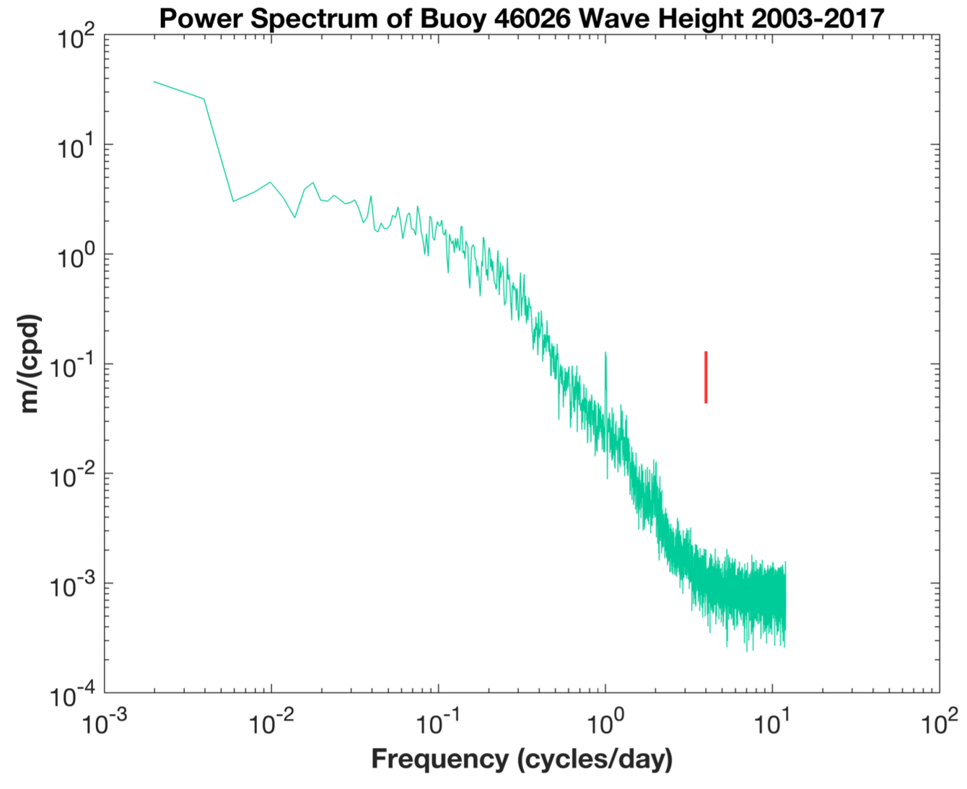
Notes:
So what were the results of this analysis?
20 total 1-SD droughts in the 118 year period
14 between 1896-1994
6 between 1995 and 2014
14% probability in nearly 100 year period
30% probability in 9 year period
All 20 events occured in -0.5 SD precipitation anomalies (not surprising → need moderately low precipitation for a drought to occur)
Precipitation deficits are more likely to produce 1-SD drought in warm years
Warm-Dry years have have occurred 2x more often in past 20 years than previous century

Slide 24
1 cycle/year
1 cycle/day
Notes:
So what were the results of this analysis?
20 total 1-SD droughts in the 118 year period
14 between 1896-1994
6 between 1995 and 2014
14% probability in nearly 100 year period
30% probability in 9 year period
All 20 events occured in -0.5 SD precipitation anomalies (not surprising → need moderately low precipitation for a drought to occur)
Precipitation deficits are more likely to produce 1-SD drought in warm years
Warm-Dry years have have occurred 2x more often in past 20 years than previous century

Slide 25
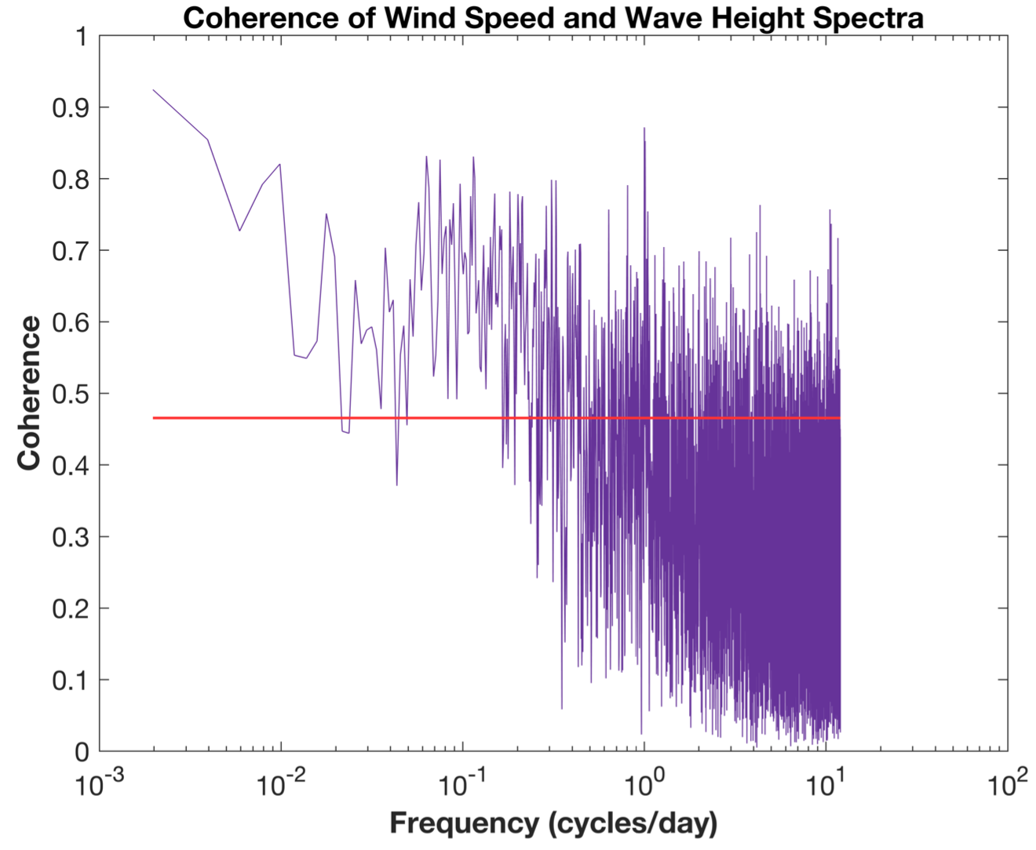
Notes:
So what were the results of this analysis?
20 total 1-SD droughts in the 118 year period
14 between 1896-1994
6 between 1995 and 2014
14% probability in nearly 100 year period
30% probability in 9 year period
All 20 events occured in -0.5 SD precipitation anomalies (not surprising → need moderately low precipitation for a drought to occur)
Precipitation deficits are more likely to produce 1-SD drought in warm years
Warm-Dry years have have occurred 2x more often in past 20 years than previous century

Slide 26
1 cycle/year
1 cycle/day
Notes:
So what were the results of this analysis?
20 total 1-SD droughts in the 118 year period
14 between 1896-1994
6 between 1995 and 2014
14% probability in nearly 100 year period
30% probability in 9 year period
All 20 events occured in -0.5 SD precipitation anomalies (not surprising → need moderately low precipitation for a drought to occur)
Precipitation deficits are more likely to produce 1-SD drought in warm years
Warm-Dry years have have occurred 2x more often in past 20 years than previous century

Slide 27
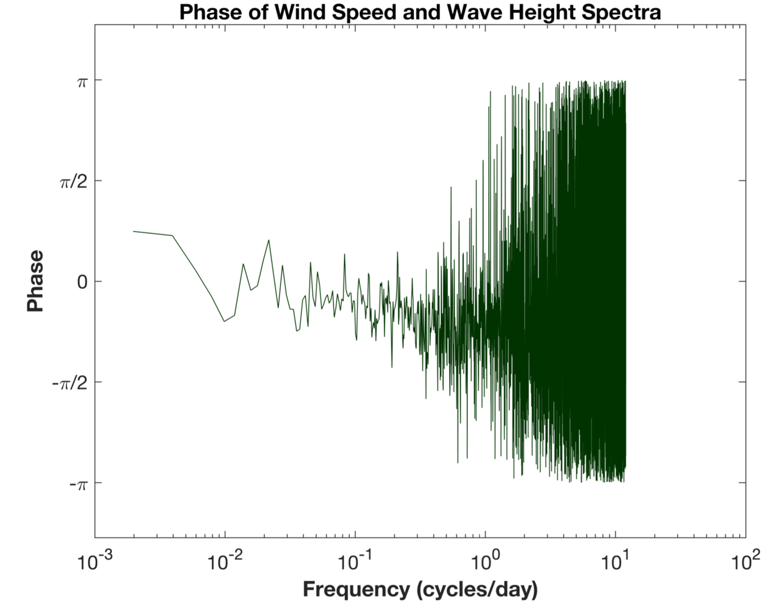
Notes:
So what were the results of this analysis?
20 total 1-SD droughts in the 118 year period
14 between 1896-1994
6 between 1995 and 2014
14% probability in nearly 100 year period
30% probability in 9 year period
All 20 events occured in -0.5 SD precipitation anomalies (not surprising → need moderately low precipitation for a drought to occur)
Precipitation deficits are more likely to produce 1-SD drought in warm years
Warm-Dry years have have occurred 2x more often in past 20 years than previous century

Slide 28
+𝜋/4
~ 45 days
Waves lead wind
-𝜋/4
~ 3.5 hours
Wind leads waves
Notes:
So what were the results of this analysis?
20 total 1-SD droughts in the 118 year period
14 between 1896-1994
6 between 1995 and 2014
14% probability in nearly 100 year period
30% probability in 9 year period
All 20 events occured in -0.5 SD precipitation anomalies (not surprising → need moderately low precipitation for a drought to occur)
Precipitation deficits are more likely to produce 1-SD drought in warm years
Warm-Dry years have have occurred 2x more often in past 20 years than previous century

Slide 29

Just for fun
Notes:
Source: https://www.drought.gov/drought/california-no-stranger-dry-conditions-drought-2011-2017-was-exceptional
With that definition in mind, brings us to the context of the paper —> California drought, technically lasted 2011-2017 but the driest years on instrumental record were were 2011-2015. California saw all 4 types of droughts and had a large impact across the state, particularly on agriculture and water use.
Note: this paper was written in 2014, published 2015 (so only looks at data up to 2014)

Slide 30
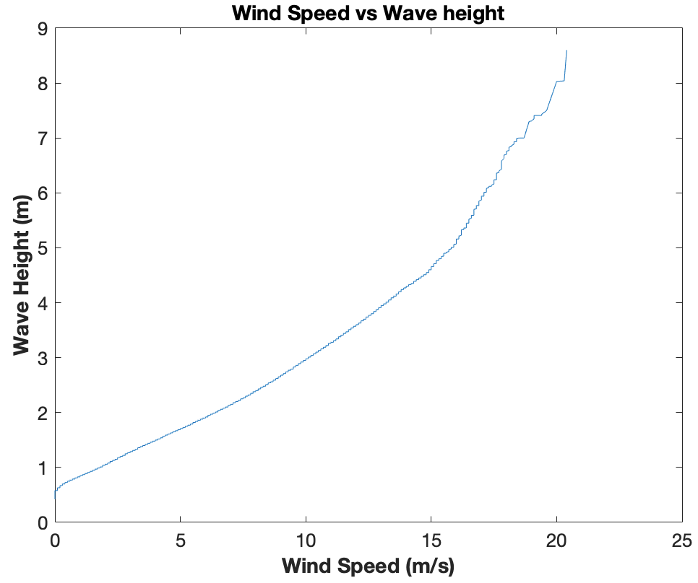
Notes:
So what were the results of this analysis?
20 total 1-SD droughts in the 118 year period
14 between 1896-1994
6 between 1995 and 2014
14% probability in nearly 100 year period
30% probability in 9 year period
All 20 events occured in -0.5 SD precipitation anomalies (not surprising → need moderately low precipitation for a drought to occur)
Precipitation deficits are more likely to produce 1-SD drought in warm years
Warm-Dry years have have occurred 2x more often in past 20 years than previous century

Slide 31
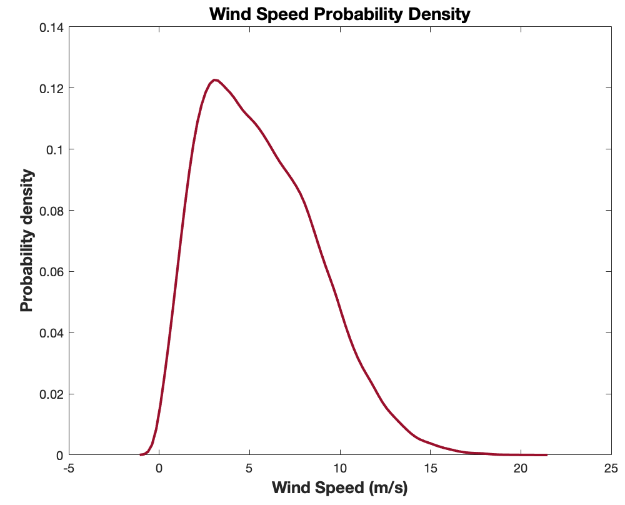
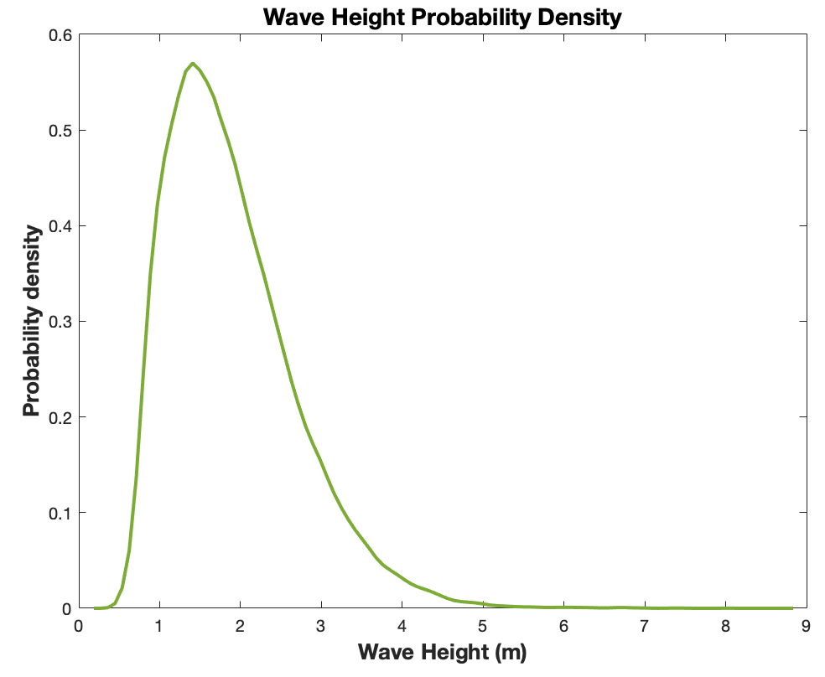
Notes:
So what were the results of this analysis?
20 total 1-SD droughts in the 118 year period
14 between 1896-1994
6 between 1995 and 2014
14% probability in nearly 100 year period
30% probability in 9 year period
All 20 events occured in -0.5 SD precipitation anomalies (not surprising → need moderately low precipitation for a drought to occur)
Precipitation deficits are more likely to produce 1-SD drought in warm years
Warm-Dry years have have occurred 2x more often in past 20 years than previous century

Slide 32

Conclusions
Statistically significant peaks in wind speed and in wave height at daily and annual frequencies
Notes:
The impact of increasing temperatures on processes like runoff, river and stream baseflow, groundwater, soil moisture, and evaporation over both the historical period and in response to further global warming remains a key aspect of uncertainty.
Climate models don’t resolve the topographic complexity of California that greatly influences the state’s temperature and precipitation.
Looking for increased model resolution.
However, it is still important to consider how anthropogenic global warming can potentially affect droughts in the state.

Slide 33
Conclusions
Statistically significant peaks in wind speed and in wave height at daily and annual frequencies
Very high coherence between wind speed and wave height at daily, annual, and sub-daily frequencies
Notes:
The impact of increasing temperatures on processes like runoff, river and stream baseflow, groundwater, soil moisture, and evaporation over both the historical period and in response to further global warming remains a key aspect of uncertainty.
Climate models don’t resolve the topographic complexity of California that greatly influences the state’s temperature and precipitation.
Looking for increased model resolution.
However, it is still important to consider how anthropogenic global warming can potentially affect droughts in the state.

Slide 34
Conclusions
Statistically significant peaks in wind speed and in wave height at daily and annual frequencies
Very high coherence (>0.9) between wind speed and wave height at daily, annual, and sub-daily frequencies
Wind lags waves at the annual frequency and waves lag wind at the daily frequency
Notes:
The impact of increasing temperatures on processes like runoff, river and stream baseflow, groundwater, soil moisture, and evaporation over both the historical period and in response to further global warming remains a key aspect of uncertainty.
Climate models don’t resolve the topographic complexity of California that greatly influences the state’s temperature and precipitation.
Looking for increased model resolution.
However, it is still important to consider how anthropogenic global warming can potentially affect droughts in the state.

